Slide 1
Understanding Quantum Information and Computation
https://www.youtube.com/watch?v=0Av89fZenSY&list=PLOFEBzvs-VvqKKMXX4vbi4EB1uaErFMSO&index=2

Slide 2
Lesson 1: Single Systems
Description of Quantum Information
  Simplified Description
    Quantum states are represented by vectors
    operation are represented by unitary matrices
    Sufficient for understanding of most quantum algorithms
    Limitations
      Model effects of noise on Quantium Systems
  General Description
    More general and broadly applicable
    Quantum states are represented by density matrices allows for a more general class of measurements and operations
    includes both the simplified description and classical information ( including probabilistic states ) as special classes
Classical Information
  Consider a physical system that stores information ( called x)
    Assumption X can be in one of a finite set of states at each moment
      Classical State – A configuration of the system that can be described unambiguously without uncertainty or error
      Denote a classical state by sigma ( Σ )

Slide 3
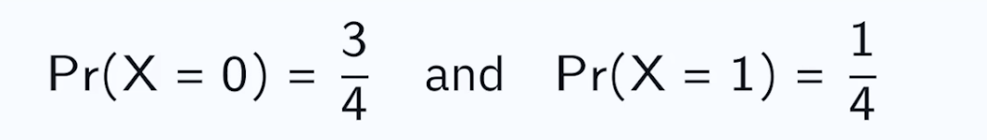
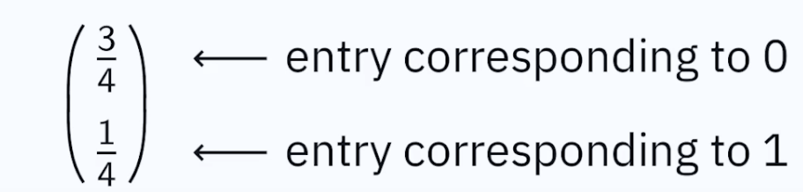
Lesson 1: Single Systems
    Example X is a bit then Σ = { 0,1}
      {0,1} – called binary alphabet
    Example X is a six sided die then Σ = { 0,1,2,3,4,5,6}
    Example X is a switch on an electrical fan then Σ = { high, meduum, low, off }
    The set must no be empty. There must be one classical state that the physical system can be in
      Need at least two classical states if the system is going to be useful for storing information
  There may be uncertainty about the classical state of the system where each classical state has some probability associated with it
    For example if X is a bit then perhaps it is in the class state 0 with a probability ¾ and a classical state 1 with a probability of ¼
      Probabilistic State of X
    A succinct way to represent this probabilistic state is by a column vector.
      The vector are all non negative real numbers
      The sum on of entries is 1
      called a probability vector
      One entry for each classical state
  Dirac Notation ( first part )
    Let Σ be any classical state set and assume elements of Σ have been placed in correspondence with integers 1 to | Σ|
    important we have an ordering and stick to it.

Slide 4
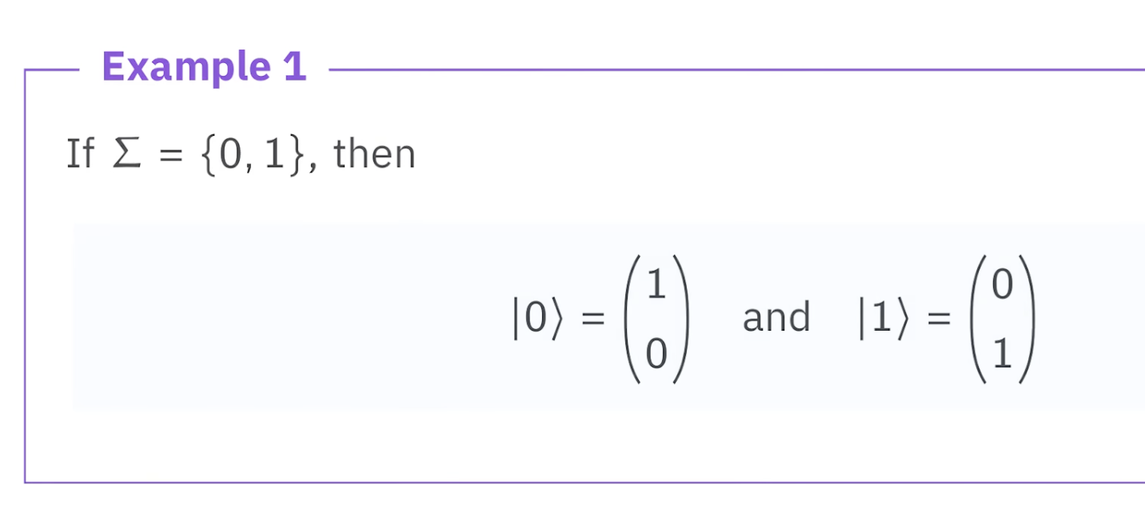
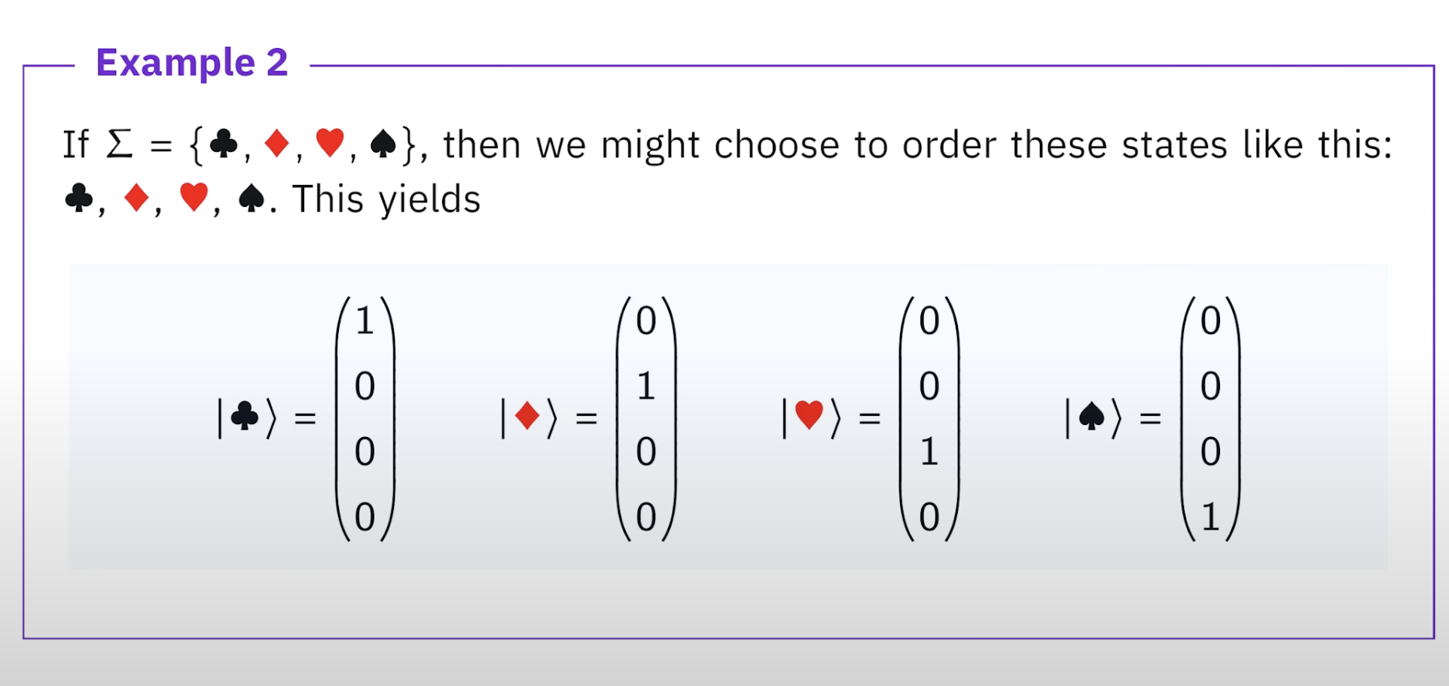
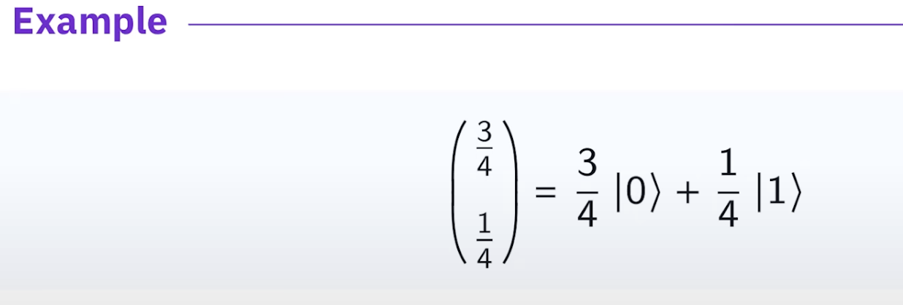
Lesson 1 – Single Systems
  We done by | a > column vectors having a 1 in the entry corresponding to a
  and a 0 for all other entries
    Vectors of this form are called standard basic vectors
      Every vector can be expressed in a unique way as a
      linear combination of standard basic vector

Slide 5
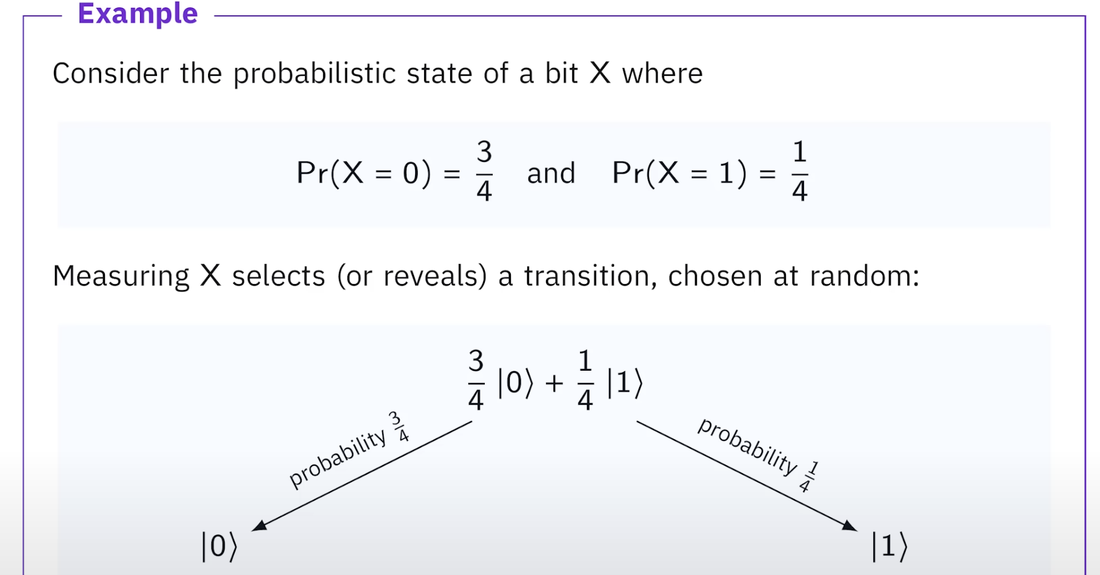
Lesson 1 – Single Systems
Measuring Probabilistic States
  What happens if we measure a system X while it is in some
  probabilistic state
  measurement – Looking at it and recognizing the state it is in.
    We see a classical state chosen at random according
    to the probabilities
    Allow us to draw a parallel with quantum information
    Suppose the classical the static that we is “a” which
    could be any state in sigma
      This changes the probabilistic state of X
      ( from our viewpoint ) having recognized
      that X is in the classical state “a” probability
      for “a” is now 1
        No uncertainty
    This probabilistic state is represented by the vector |a>
      By measuring all uncertainty is removed
    To another person who did not see the classical state of
    X was when we measured the probabilistic state would not
    have had for that person
      Different person can have different knowledge of a particular system and choose different probabilistic states to represent their knowledge of that system

Slide 6
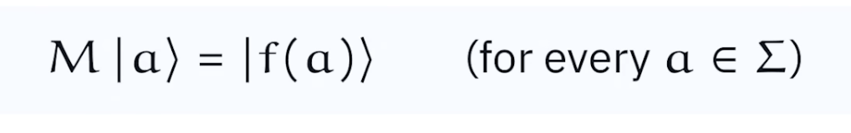
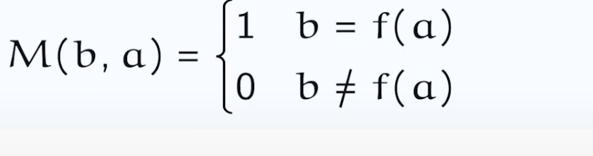
Lesson 1 – Single Systems
Operations performed on a system
  Deterministic Operations
    The state depends on the prior state the operation is applied to
    No uncertainty
    Every Function f: Σ → Σ describes a deterministic operation that transforms the classical state a into f(a) for each a in the set
      The two sigmas are input and output respectfully
    Given every function f: Σ → Σ there is a unique matrix M satisfying
      M * |a = |f(a)> for every element in the set Σ
        M *|a → Multiplying M * a
      The matrix “M” will always have exactly one 1 in each column and 0 for all the other entries
        M(b,a) where 1 if b = f(a) and 0 if b is not equal to f(a)
      Used for a system system in a probabilistic state and perform a deterministic operation the resulting probabilistic state can be obtained by matrix vector multiplication
        arrow with bar is a transformation operation

Slide 7
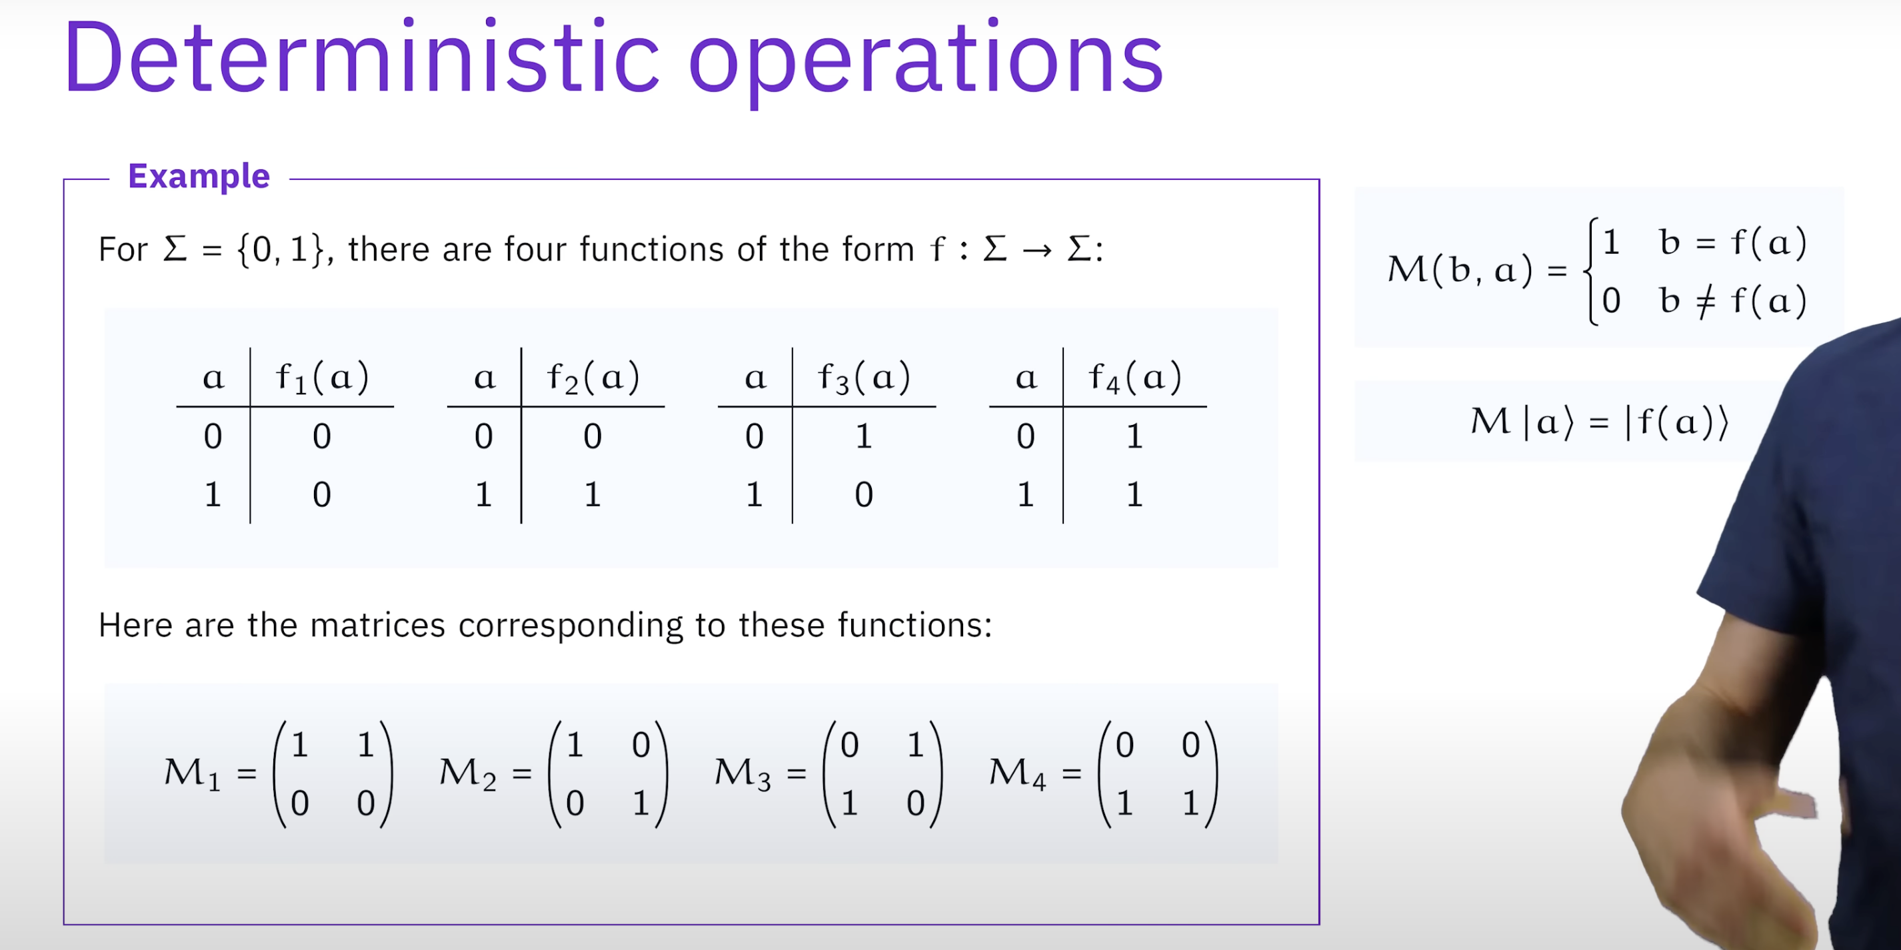
Lesson 1 – Single Systems
Example of Deterministic state
  Only four functions of the binary alphabet
    f1 is constant 0 function
    f2 is identity function
    f3 is not function
    f4 is constant 1 function
  Create the matrix m1 – M ( b, a)
    b = 0, a = 0 c = 1
    b = 0, a = 1 c = 1
    b = 1, a = 0 c = 0
    b = 1, a = 1 c = 0
  Check the second formula is true
    Remember a is the state
    M3 is matrix
    The State can be either 0 or 1 so for the first state
      M3 * [0,1] for final state 1
      M3 * [1,0] for final state 0

